Slide 1
FY24 SAP Timesheet Improvement Activity
Japan RBU

Slide 2
Background & Objectives
Following the FJ audit result in FY23 Q4, improvement areas were identified around the following:
Increase accuracy of SAP timesheet and billing records
SAP Timesheet is mandatory to all GDC employees
SAP timesheet guide to be shared based on new CC structure & details about which activities are billable / non-billable
Proper charging of project-related and non-project related tasks to appropriate WBS #
SAP timesheet inputs to be the basis of activity reports (for T&M billing – majority of Japan projects)
Implement automation from SAP timesheet data going to Activity Report (fixed template from FJ)
Parallel manual run & automation in May – for comparison purpose
Target June onwards: automated process only

Slide 3
Overview
Old and New Cost Centers for JDU & Non-JDU
Pre-requisites for filing Timesheet
SAP Timesheet Guide - Billable project members (JDU)
SAP Timesheet Guide – New Hires & Bench (JDU)
SAP Timesheet Guide - Billable project members (Non-JDU)
SAP Timesheet Guide – Bench (Non-JDU)
Sample Timesheet Entries Scenarios
SAP Timesheet Approval and Rejection Guide for Managers
Project WBS Structure
Common issues encountered/Reminders
Links

Slide 4
SAP Timesheet Guide

Slide 5
Old and New Cost Centers - JDU
BILLABLE COST CENTER:
-Project WBS
-Management fee WBS (new)
OLD Structure |  |  |  | New Structure
Service Line | Cost Centers | Operations Manager |  | Service Line |  | Cost Centers | Cost Centers Name | Operations Manager
Application Services (AS) | 51APJFD032 | Ronald Etcubañas |  | Application & Managed Services (APMS = JDU AS and JDU-AMS merged) | JDU ASMS | 51APJFD039 | JDU ASMS MNL | Ronald Etcubañas
 | 51APJFD033 |  |  |  |  | 52APJFD039 | JDU ASMS CEB
 | 51APJFD035 |  |  |  |  | 51APJFD040 | JDU ASMS Umbrella MNL
 | 52APJFD032 |  |  |  |  | 52APJFD040 | JDU ASMS Umbrella CEB
 | 52APJFD033
Advance Architect Services (A2S) | 51APJFD033 | Kazuhiko Hirahira |  | Advance Architect Services (A2S) | JDU A2S | 51APJFD043 | JDU A2S MNL | Kazuhiko Hirahira
 |  |  |  |  |  | 52APJFD043 | JDU A2S CEB
 | 52APJFD033 |  |  |  |  | 51APJFD044 | JDU A2S Umbrella MNL
 |  |  |  |  |  | 52APJFD044 | JDU A2S Umbrella CEB
Solution Shared Services (SSS) | 51APJFD031 | Gem Orevillo |  | Solution Shared Services (SSS) | JDU SSS | 51APJFD041 | JDU SSS MNL | Gem Orevillo
 | 51APJFD032
 | 51APJFD033 |  |  |  |  | 52APJFD041 | JDU SSS CEB
 | 51APJFD037
 | 51APJFD038 |  |  |  |  | 51APJFD042 | JDU SSS Umbrella MNL
 | 52APJFD032
 | 52APJFD033 |  |  |  |  | 52APJFD042 | JDU SSS Umbrella CEB
 | 52APJFD037
Global Resource Exchange for Accelerating Transformation (GREAT) | 51APJFD032 | Gerly Vapor |  | Global Resource Exchange for Accelerating Transformation (GREAT) | JDU GREAT | 51APJFD045 | JDU GREAT MNL | Gerly Vapor
 | 51APJFD033
 | 51APJFD035 |  |  |  |  | 52APJFD045 | JDU GREAT CEB
 | 52APJFD033
Application Managed Service (AMS) | 51APJFD033 | Avegail Mijares |  | JDU-AMS merged with JDU-AS = JDU-APMS
 | 52APJFD033
UMBRELLA/BENCH COST CENTER:
-Umbrella WBS (to be subdivided – slide 8)
Planning Team Support (PTS-OTHERS) | 51APJFD032 | members are from different SL |  | JDU Planning Team Support (PTS-OTHERS) | JDU PTS Others | 51APJFD046 | PTS Others MNL | Avegail Mijares
 | 51APJFD033 |  |  |  |  | 52APJFD046 | PTS Others CEB
Japanese Assignee | 51APJFD033 | all JDU |  | Japanese Assignees | Japanese Assignees | 51APJFD048 | Japanese Assignees MNL | Avegail Mijares
 | 52APJFD033 |  |  |  |  | 52APJFD048 | Japanese Assignees CEB

Slide 6
Old and New Cost Centers – Non JDU
OLD Structure |  |  |  | New Structure
Service Line | Cost Centers | Operations Manager |  | Service Line |  | Cost Centers | Cost Centers Name | Operations Manager
Business Process Services (BPS) | 51APJFD032 | Gerly Vapor |  | Business Process Services (BPS) | BPS | 51APJFD047 | BPS MNL | Gerly Vapor
 | 52APJFD032 |  |  |  |  | 52APJFD047 | BPS CEB
Applications Development (APPS DEV) | 51APJFD032 | Jambert De Guzman |  | Applications Development (APPS DEV) | Apps Dev | 51APJFD032 | APP DEV MNL | Jambert De Guzman
 | 52APJFD032 |  |  |  |  | 52APJFD032 | APP DEV CEB
WSJ | 51APJFD031 | Gerly Vapor |  | WSJ | Weserv Japan | 51APJFD031 | Weserv Japan MNL | Gerly Vapor
 | 52APJFD031 |  |  |  |  | 52APJFD031 | Weserv Japan CEB
Fujitsu Japan | 51APJFD036 | Geraldine Mabale |  | Fujitsu Japan | Fujitsu Japan | 51APJFD036 | Fujitsu Japan MNL | Geraldine Mabale
 | 52APJFD036 |  |  |  |  | 52APJFD036 | Fujitsu Japan CEB
Japan RBU DELIVERY MNGMT | 51APJFD034 | Geraldine Mabale |  | Japan RBU DELIVERY MNGMT | Japan RBU DELIVERY MNGMT | 51APJFD034 | FDC Del Mgt MNL | Geraldine Mabale
 | 52APJFD034 |  |  |  |  | 52APJFD034 | FDC Del Mgt CEB

Slide 7
Pre-requisites for filling Timesheet
Ensure that Employee User is in SAP ESS/MSS
Setup is done by HR for new Hires
Assigning Employee to a Project
PSRF and ReSQ Guide.pptx
Ensure that Leaves are already approved in Zinzai

Slide 8
SAP Timesheet Guide - Billable project members (JDU)
Project-related Tasks | Cost Center / WBS Element | Activity Type | Remarks
Project Preparation/Environment Set-up tasks | Project WBS | Billable Labor | Includes coordination with support groups (MIS, Procurement, InfoSec, etc.), applicable also for project room preparation
Actual Project tasks |  |  | Dev, Infra, Reviews, Kaizen tasks, etc.
QA/Issues, Consultation, Member Support
Project Meetings |  |  | Team meetings (asakai/yuukai), Weekly project meetings/reporting (internal & with Japan)
KT/Project-specific Trainings
Project Management tasks |  |  | Includes all PM-related reports (initiation to closing), MBR creation, case study creation, PM’s tasks related to PMO & SGC audits/requests; PPR/CSAT-related (incl. RCAs)
Commercials & Finance Management |  |  | Estimation, Quotation, Man-hour management (Plan vs Actual), Finance processes (PSRF, Re-SQ, Billing Advice, HC&Rev update, SAP WBS enrolment, etc.); [For T&M projects] Activity Report creation, SS Mart related tasks
Information Security tasks |  |  | Monthly Security Audit (self-check & project-related updates), Security processes for Joiners, Movers, Leavers (JML), Security incident-related tasks (investigation, RCA, NTE) (if occurred)
Business Trip tasks |  |  | Includes preparations & post-processing
Overtime |  | Billable Overtime | Pre-approval of Japan counterpart required

Slide 9
SAP Timesheet Guide - Billable project members (JDU)
Non-project related tasks | Cost Center / WBS Element | Activity Type | Remarks
JDU meetings – Members & PM | Project WBS* | Billable Labor | Regular meetings within JDU, PFA/PA, CCB meetings, MBR Discussion etc.
BG/BU/JGG/JDU townhalls & assembly – Members & PM |  |  | Visitor F2F meetings (incl. preparations) & townhalls, online meetings & townhalls with BG/BU/JGG; JDU service line townhalls; JDU assembly, JDU Global orientation
JDU-mandated trainings
Organizational Activities & Improvements – Members & PM |  |  | Survey responses, Knowledge Sharing / Yokotenkai sessions, CSIP, etc.
Information Security Audit tasks |  |  | Security Leads & PICs conducting audit of service line members’ monthly security reports
Resource Management |  |  | Goal Setting, Connect Conversation, Performance Evaluation, Regularization-related evaluations (3rd and 5th month eval),1-on-1 meetings; HR disciplinary action (NTE, admin hearing) & PIP-related tasks, Promotion/Salary adjustment, QIB, STARS process-related tasks
Organizational Management – LM up | Management fee WBS | Billable Labor | Service Line management tasks (incl. resource, pipeline, finance management, project control)
PMO activities
 |  |  | PMO-Process members’ tasks
JDU meetings – LM up
JDU meetings |  |  | JDU service line weekly meetings (various levels), PFA/PA, CCB meetings, MBR Discussion etc.
BG/BU/JGG/JDU townhalls & assembly – LM up |  |  | Visitor F2F meetings (incl. preparations) & townhalls, online meetings & townhalls with BG/BU/JGG; JDU service line townhalls; JDU assembly, JDU Global orientation
*tentative: Indirect Work sub-WBS element under discussion

Slide 10
SAP Timesheet Guide - Billable project members (JDU)
Non-project related tasks | Cost Center / WBS Element | Activity Type | Remarks
Non-JDU meetings / townhall | Project WBS* | Non-billable Labor | Japan RBU meetings, etc.
GDC meetings / townhall |  |  | GDC kick-off, leadership workshops, townhalls, Christmas party, etc.
Quarterly Team Development (QTD), Ikigai activities
GDC-mandated Trainings, Self-learning (SABA, Linkedin Learning, own initiative trainings) | Cost Center | TRAINING | GDC-mandated Trainings, Self-learning (SABA, Linkedin Learning, own initiative trainings)
GRIP activities | Cost Center | GRIP
Leave | Cost Center | LEAVE | Select proper code depending on Leave Type
HR and Admin Activities | Cost Center | OTHERS | SAP timesheet update, Sunfish update, Daily attendance/BCP update, Zinzai leaves update, e-memo creation and approvals (non-project specific only; if project-specific, charge to Project WBS), PC issues troubleshooting / replacement, etc. (non-project specific only such as asset issue/MSR; if project-specific like environment set-up & troubleshooting, charge to Project WBS)
*tentative: Indirect Work sub-WBS element under discussion

Slide 11
SAP Timesheet Guide – New Hires & Bench (JDU)
TASKS | Cost Center / WBS Element | Activity Type | Remarks
GDC Onboarding Trainings (for New Hires) | Cost Center | TRAINING | Fresh Start (HR), JP RBU Orientation, Onboarding Trainings
JDU Training - New Hires | Training – New Hires WBS | Billable Labor | JDU Standardization training (20 MD)
JDU Training - Bench | Training – Bench WBS | Billable Labor | Trainings assigned by PMO / managers during bench; JDU-mandated trainings
Internal Project | Internal Project WBS | Billable Labor | Internal Projects (automation, etc)
OJT | OJT WBS | Billable Labor | OJT projects
JDU meetings | Depending on which WBS member is registered to*: Training – New Hires WBS / Training – Bench WBS / Internal Project WBS / OJT WBS | Billable Labor | Regular meetings within JDU
BG/BU/JGG/JDU townhalls & assembly |  |  | Visitor F2F meetings (incl. preparations) & townhalls, online meetings & townhalls with BG/BU/JGG; JDU service line townhalls; JDU assembly, JDU Global orientation
Organizational Activities & Improvements |  |  | Survey responses, Knowledge Sharing / Yokotenkai sessions, CSIP, etc.
Information Security tasks |  |  | Monthly Security Audit (self-check), Security processes for Joiners, Movers, Leavers (JML), Security incident-related tasks (investigation, RCA, NTE) (if occurred); Security Leads & PICs conducting audit of service line members’ monthly security reports
Resource Management |  |  | Goal Setting, Connect Conversation, Performance Evaluation, Regularization-related evaluations (3rd and 5th month eval),1-on-1 meetings; HR disciplinary action (NTE, admin hearing) & PIP-related tasks, Promotion/Salary adjustment, QIB, STARS process
Non-JDU meetings / townhall | Depending on which WBS member is registered to*: Training – New Hires WBS / Training – Bench WBS / Internal Project WBS / OJT WBS | Non-billable Labor | Japan RBU meetings, etc.
GDC meetings / townhall |  |  | GDC kick-off, leadership workshops, townhalls, Christmas party, etc.
Quarterly Team Development (QTD), Ikigai activities
GDC-mandated Trainings, Self-learning (SABA, Linkedin Learning, own initiative trainings) | Cost Center | TRAINING | GDC-mandated Trainings, Self-learning (SABA, Linkedin Learning, own initiative trainings)
GRIP activities | Cost Center | GRIP
Leave | Cost Center | LEAVE | Select proper code depending on Leave Type
HR and Admin Activities | Cost Center | OTHERS | SAP timesheet update, Sunfish update, Daily attendance/BCP update, Zinzai leaves update, e-memo creation and approvals,PC issues troubleshooting / replacement, etc.
*tentative: Indirect Work sub-WBS element under discussion
Notes:
Umbrella Re-SQ: Estimated/planned rev: split amount between new hires & bench WBS
Umbrella Timesheet = Actuals; depends on actual activity type (4 WBS)

Slide 12
SAP Timesheet Guide - Billable project members (Non-JDU)
Project-related Tasks | Cost Center / WBS Element | Activity Type | Remarks
Project Preparation/Environment Set-up tasks | Project WBS | Billable Labor | Includes coordination with support groups (MIS, Procurement, InfoSec, etc.), applicable also for project room preparation
Actual Project tasks |  |  | Dev, Infra, Reviews, Kaizen tasks, etc.
QA/Issues, Consultation, Member Support
Project Meetings |  |  | Team meetings (asakai/yuukai), Weekly project meetings/reporting (internal & with Japan)
KT/Project-specific Trainings
Project Management tasks |  |  | Includes all PM-related reports (initiation to closing), MBR creation, case study creation, PM’s tasks related to PMO & SGC audits/requests; PPR/CSAT-related (incl. RCAs)
Commercials & Finance Management |  |  | Estimation, Quotation, Man-hour management (Plan vs Actual), Finance processes (PSRF, Re-SQ, Billing Advice, HC&Rev update, SAP WBS enrolment, etc.); [For T&M projects] Activity Report creation, SS Mart related tasks
Information Security tasks |  |  | Monthly Security Audit (self-check & project-related updates), Security processes for Joiners, Movers, Leavers (JML), Security incident-related tasks (investigation, RCA, NTE) (if occurred)
Business Trip tasks |  |  | Includes preparations & post-processing
Overtime |  | Billable Overtime | Pre-approval of Japan counterpart required

Slide 13
SAP Timesheet Guide for Project/WBS# - Billable project members (Non-JDU)
Non-project related tasks | Cost Center / WBS Element | Activity Type | Remarks
Non-JDU meetings / townhalls | Project WBS* | Non-billable Labor | Regular meetings within non-JDU, PFA/PA, CCB meetings, MBR Discussion etc.
BG/BU townhalls |  |  | Visitor F2F meetings (incl. preparations) & townhalls, online meetings & townhalls with BG/BU/JGG; JDU service line townhalls; JDU assembly, JDU Global orientation
Organizational Activities & Improvements |  |  | Survey responses, Knowledge Sharing / Yokotenkai sessions, CSIP, etc.
Information Security Audit tasks |  |  | Security Leads & PICs conducting audit of service line members’ monthly security reports
Resource Management |  |  | Goal Setting, Connect Conversation, Performance Evaluation, Regularization-related evaluations (3rd and 5th month eval),1-on-1 meetings; HR disciplinary action (NTE, admin hearing) & PIP-related tasks, Promotion/Salary adjustment, QIB, STARS process
GDC meetings / townhall |  |  | GDC kick-off, leadership workshops, townhalls, Christmas party, etc.
Quarterly Team Development (QTD), Ikigai activities
GDC-mandated Trainings, Self-learning (SABA, Linkedin Learning, own initiative trainings) | Cost Center | TRAINING | GDC-mandated Trainings, Self-learning (SABA, Linkedin Learning, own initiative trainings)
GRIP activities | Cost Center | GRIP
Leave | Cost Center | LEAVE | Select proper code depending on Leave Type
HR and Admin Activities | Cost Center | OTHERS | SAP timesheet update, Sunfish update, Daily attendance/BCP update, Zinzai leaves update, e-memo creation and approvals,PC issues troubleshooting / replacement, etc.

Slide 14
SAP Timesheet Guide – Bench (Non-JDU)
TASKS | Cost Center / WBS Element | Activity Type | Remarks
GDC Onboarding Trainings (for New Hires) | Cost Center | TRAINING | Fresh Start (HR), JP RBU Orientation, Onboarding Trainings
Training - Bootcamp | Bench WBS (PHC-18018) | Non-Billable Labor
Training – Bench, Internal Project | Bench WBS (PHC-18018) | Non-Billable Labor
OJT | Project WBS | Non-Billable Labor | Enroll & charge to the specific project WBS where bench member is doing OJT
Meetings | Bench WBS (PHC-18018) | Non-Billable Labor | Regular meetings within non-JDU
Townhalls & assembly |  |  | Visitor F2F meetings (incl. preparations) & townhalls, online meetings & townhalls with BG/BU/JGG; JDU service line townhalls; JDU assembly, JDU Global orientation
Organizational Activities & Improvements |  |  | Survey responses, Knowledge Sharing / Yokotenkai sessions, CSIP, etc.
Information Security tasks |  |  | Monthly Security Audit (self-check), Security processes for Joiners, Movers, Leavers (JML), Security incident-related tasks (investigation, RCA, NTE) (if occurred); Security Leads & PICs conducting audit of service line members’ monthly security reports
Resource Management |  |  | Goal Setting, Connect Conversation, Performance Evaluation, Regularization-related evaluations (3rd and 5th month eval),1-on-1 meetings; HR disciplinary action (NTE, admin hearing) & PIP-related tasks, Promotion/Salary adjustment, QIB, STARS process
Quarterly Team Development (QTD), Ikigai activities
GDC-mandated Trainings, Self-learning (SABA, Linkedin Learning, own initiative trainings) | Cost Center | TRAINING | GDC-mandated Trainings, Self-learning (SABA, Linkedin Learning, own initiative trainings)
GRIP activities | Cost Center | GRIP
Leave | Cost Center | LEAVE | Select proper code depending on Leave Type
HR and Admin Activities | Cost Center | OTHERS | SAP timesheet update, Sunfish update, Daily attendance/BCP update, Zinzai leaves update, e-memo creation and approvals,PC issues troubleshooting / replacement, etc.

Slide 15
How to properly input timesheet in SAP
Sample Scenarios

Slide 16
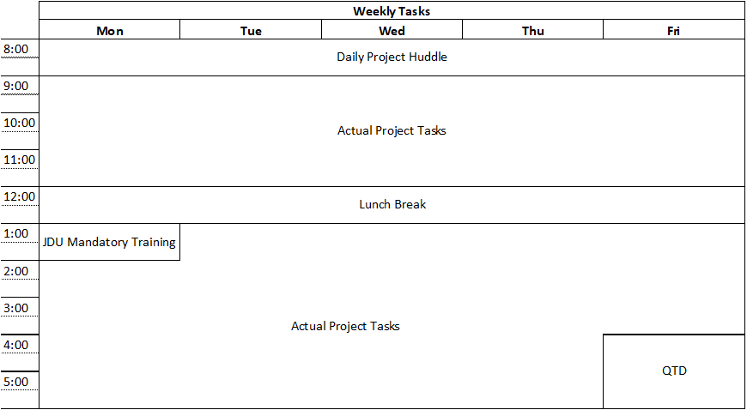
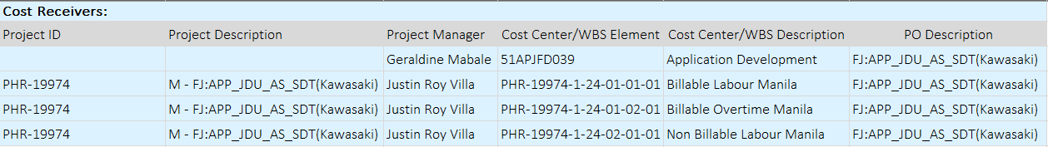
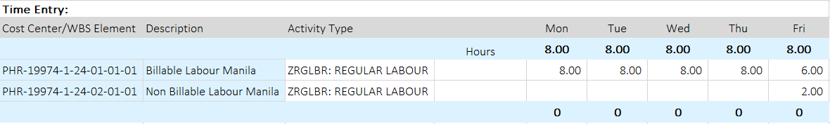
Timesheet entries for Billable JDU Member
QTD
Notes:
Scenarios:
Billable
JDU member
JDU PM
Bench member (Training-Bench 50% ; Internal Project 50%)
Non-JDU member
Non-JDU PM

Slide 17
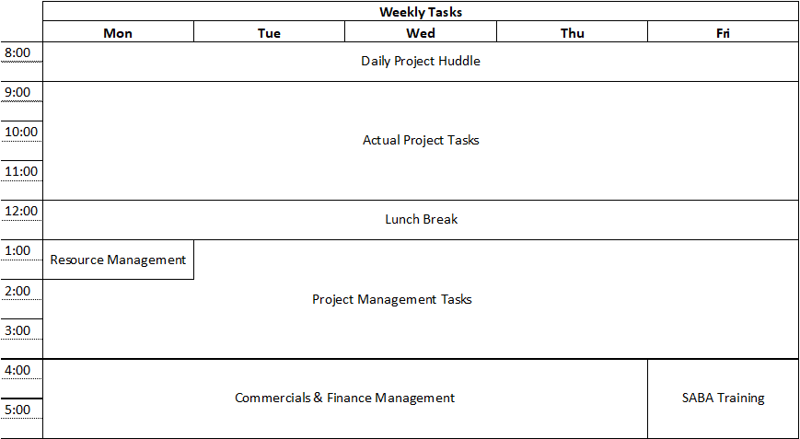
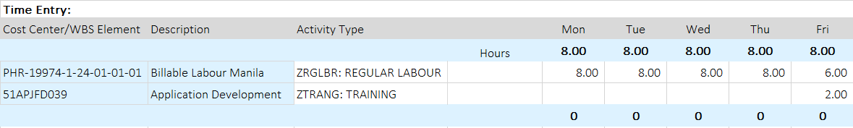
Timesheet entries for Billable JDU PM
Saba Training
Notes:
Scenarios:
Billable
JDU member
JDU PM
Bench member (Training-Bench 50% ; Internal Project 50%)
Non-JDU member
Non-JDU PM

Slide 18
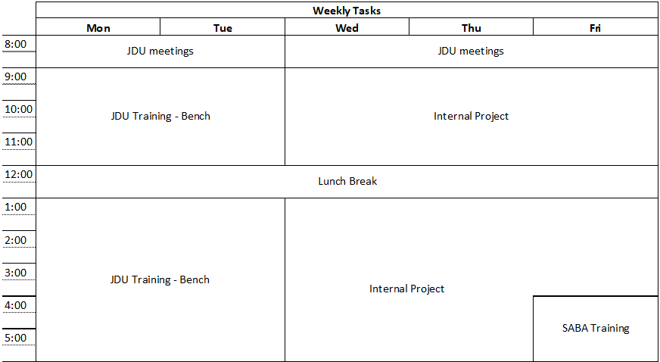
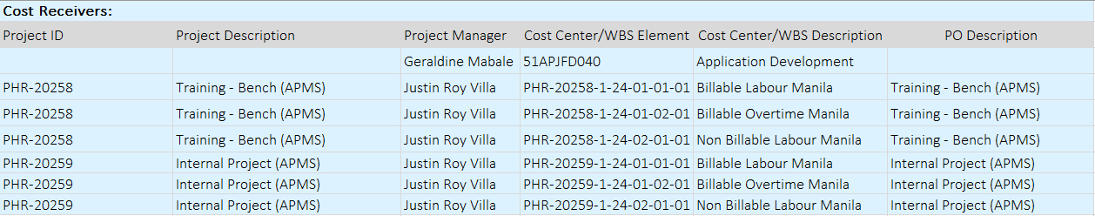
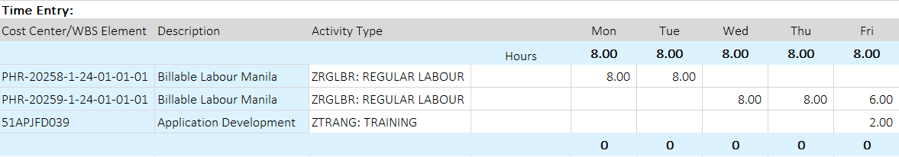
Bench Member (Training-Bench 50% ; Internal Project 50%)
Saba Training
Notes:
Scenarios:
Billable
JDU member
JDU PM
Bench member (Training-Bench 50% ; Internal Project 50%)
Non-JDU member
Non-JDU PM

Slide 19
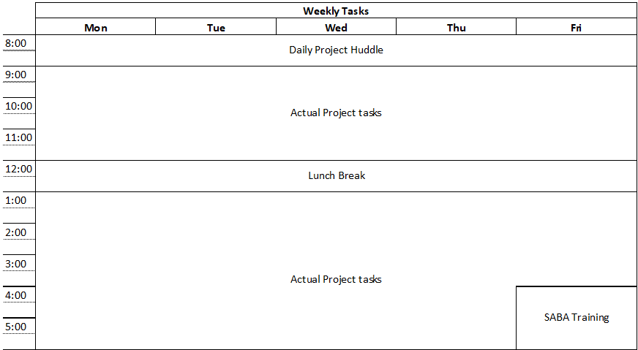
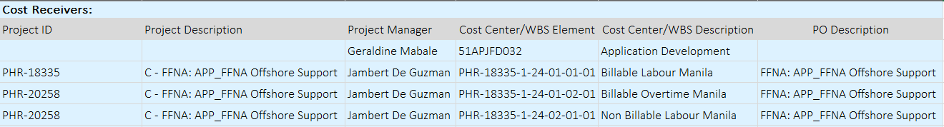

Timesheet entries for Billable Non-JDU Member
Saba Training
Notes:
Scenarios:
Billable
JDU member
JDU PM
Bench member (Training-Bench 50% ; Internal Project 50%)
Non-JDU member
Non-JDU PM

Slide 20
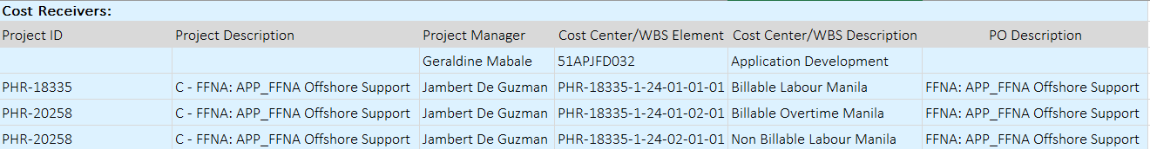
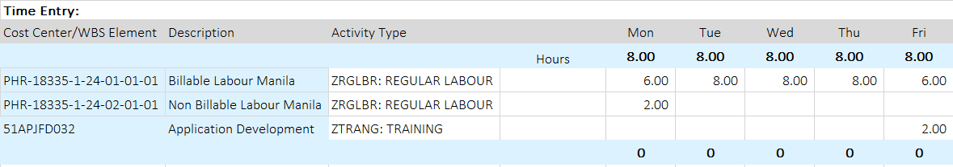
Timesheet entries for Billable Non-JDU PM
Saba Training
Notes:
Scenarios:
Billable
JDU member
JDU PM
Bench member (Training-Bench 50% ; Internal Project 50%)
Non-JDU member
Non-JDU PM

Slide 21
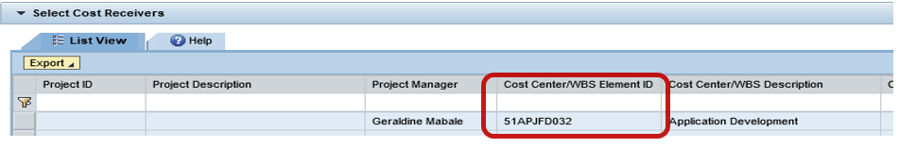
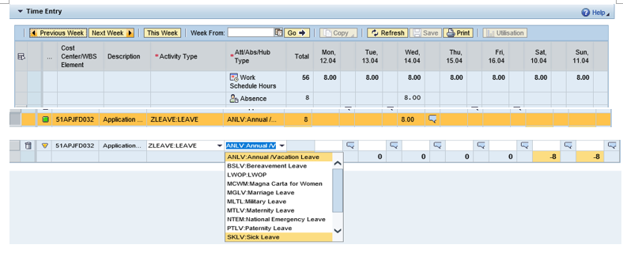
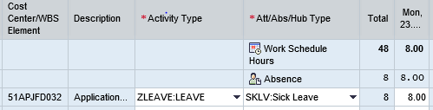
Filing of Leave in Cost Center#
Note: leave timesheet can be booked only for approved leave day. In addition, the leave type needs to be selected correctly and aligned in Zinzai (Please do not select the Proj./WBS# - PHR18xxxx-1-24)
If half-day 4.0hr. –charge to cost center#/Leave
Other half 4.0hr. Charge to Project activity
In case there is an advance timesheet entries, leave should be updated upon approved.

Slide 22
SAP Timesheet Approval and Rejection Guide
For Timesheet Approvers (PMs/Managers)

Slide 23
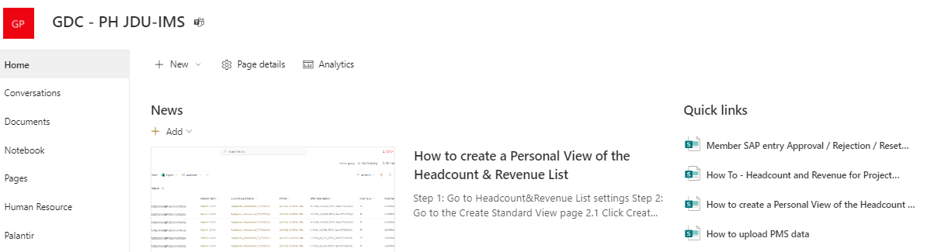

How to Approve and Reject
Please see link below:
Member SAP entry Approval / Rejection / Reset Approval (sharepoint.com)
Weekly approval of members’ timesheet by PM
PM to guide members proper charging in SAP Timesheet

Slide 24
Project WBS Structure

Slide 25
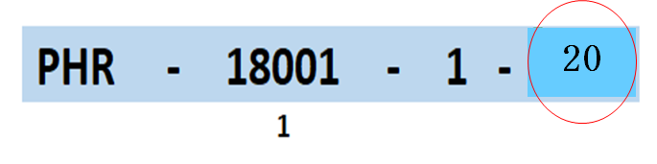
Project/WBS# Structure
Fiscal Year
24
- Standard for all Revenue and Delivery Projects
- Numbers are automatically assigned in the system upon project creation

Slide 26
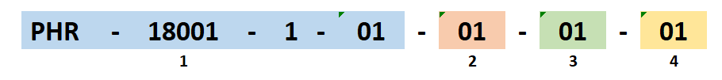
Cost Description
24
For BILLABLE (01) charges
01 - Labor (regular working hours)
02 - Overtime (in excess of 8 hours)
03 - Travel
04 - Other Expenses (equipment, licenses, books etc.)
No more “Non-billable overtime?”
For NON-BILLABLE (02) charges
01 - Labor (regular working hours)
02 - Travel
03 - Other Expenses (equipment, licenses, books etc.)

Slide 27
Resource Location
24
Manila Resources = “01” Cebu Resources = “02”.
This is automatically restricted in the system based on the master file maintained by HR team

Slide 28
Common Issues Encountered

Slide 29
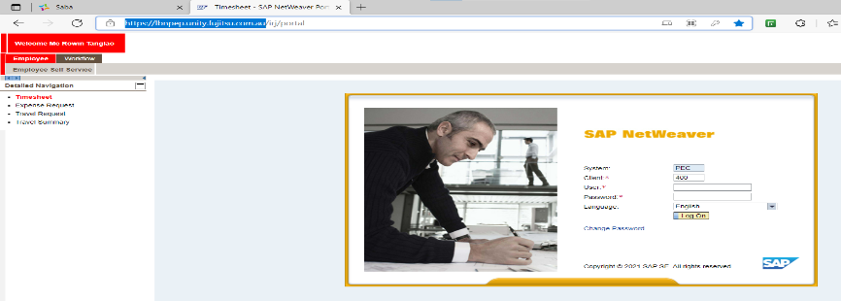
Common issues Encounter
# | Common issue encounter in SAP Timesheet | Action needed
1 | Employee SAP ID not created on time - New Joiner, onboarding processing | raise ticket to askHR
2 | Employee is unable to login ESS portal: Employee reports of getting "Page cannot be displayed" while trying to open ESS/MSS portal "No Portal Roles Assigned" | raise ticket to IT/MIS Refer to Flow of Issue Ticket Resolution
 | or inactive account (more than 1 month not connected via GlobalProtect)
3 | Employee is Unable to Book Timesheet Getting error "Accounting data is Missing" - this error refers to employee salary data not maintain in SAP emp. Profile | raise ticket to IT/MIS, askHR Refer to Flow of Issue Ticket Resolution
4 | Employee gets the error "This is not Project Assignment Period" - it means need to check member project assignment - Project/WBS# expiry date set in the system or need for extension - Wrong Project assignment | coordinate with PM for enrollment PM coordinate with Finance & File re-SQ for Extension & SAP admin (c/o Ana C.) to execute the enrollment
 | Employee is unable to see the Project/WBS#, Bench-WBS#, or any WBS# assigned | coordinate with PM for enrollment & SAP admin (c/o Ana C.) to execute the enrollment
5 | For Leave filling to cost center# - unapproved leave via zinzai - sometime cancel leave via zinzai | needs to get approval by Manager via Zinza & wait after 2hrs. before updating in SAP If still getting error, kindly raise a ticket to IT/MIS
6 | Cost center# not aligned (Zinzai & SAP) - due to Transfer/Employee movement If still getting errors, any of the following: - if within the same CostCenter# - releasing Manager/approver initiate transfer via Zinzai - if transfer from CostCenter# to another CostCenter # | raise to askHR to align Zinzai & SAP.
7 | Employee is unable to cancel, delete or modification after month-end (previous months) | no action needed, updating is not acceptable anymore (once processed by Finance)

Slide 30
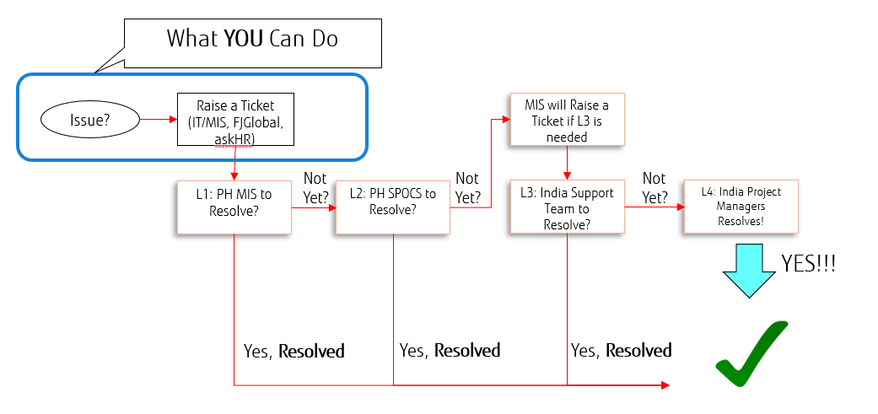
Flow of Issue Ticket Resolution

Slide 31
Reminders

Slide 32
Reminders:
PM should ensure that your members are enrolled properly assigned to Project/WBS# (ex.: monitoring of membership assignment date)
PM should review the correctness of your members’ timesheet on a weekly basis (shared in PM/gc via teams chat re: SAP Timesheet reminder – thru CATS_DA file) on or before month-end by Finance.
PM should ensure with members with long vacation leave that their timesheets are updated
PM should coordinate with SAP Admin (Ana C.) in case an employee has long leave for more than 1month (ex.: Maternity Leave, Sickness)
To avoid error in SAP Timesheet such as Project Assignment Period make sure to use the Fiscal Year End as the Project End Date in re-SQ.
PM ensure accuracy of SAP timesheet data as this will become the basis for billing (T&M) moving forward

Slide 33
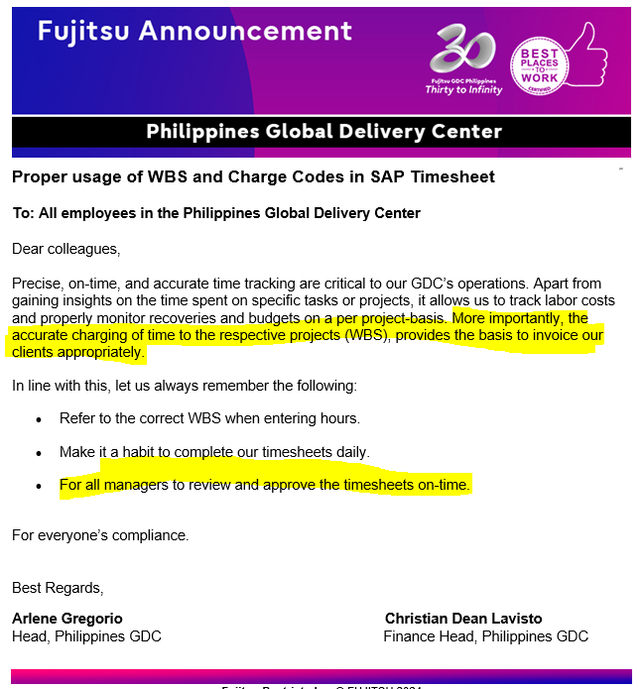
Reminders:

Slide 34
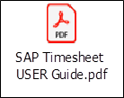
Links
SAP Portal
SAP NetWeaver Portal (fujitsu.com.au)
SAP Timesheet Guide

